Slide 1

Disaster Tweets
kmt2, nzahmad, azwang, upark
10-315

Slide 2
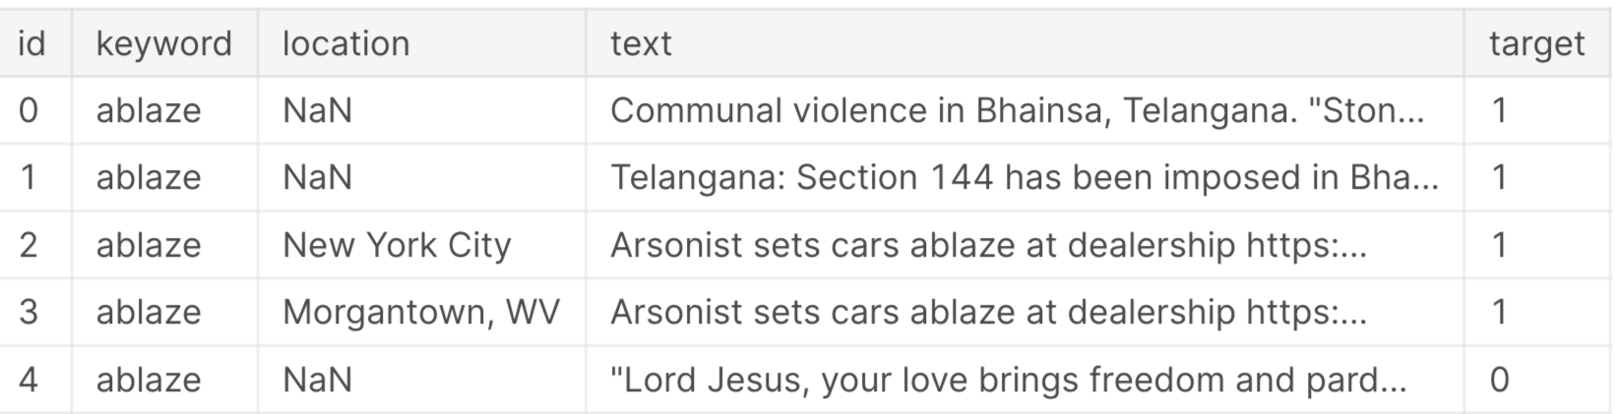
Dataset
11,000+ samples
5 features
Id, Keyword, Location, Text, Target
i.e. {ablaze, India, How can you turn a blind eye to the incident of setting ablaze more...}
Tweet topics
Taal Volcano eruption, Coronavirus, Australia bushfires, etc
Notes:
Our goal for this project is to create an accurate classifier to distinguish between real and fake disaster tweets. This is motivated by the tendencies of netizens to latch on to “newsworthy” and provocative content without much investigation. An accurate classifier would help social media companies avoid promoting harmful misinformation and promote useful messages.

Slide 3
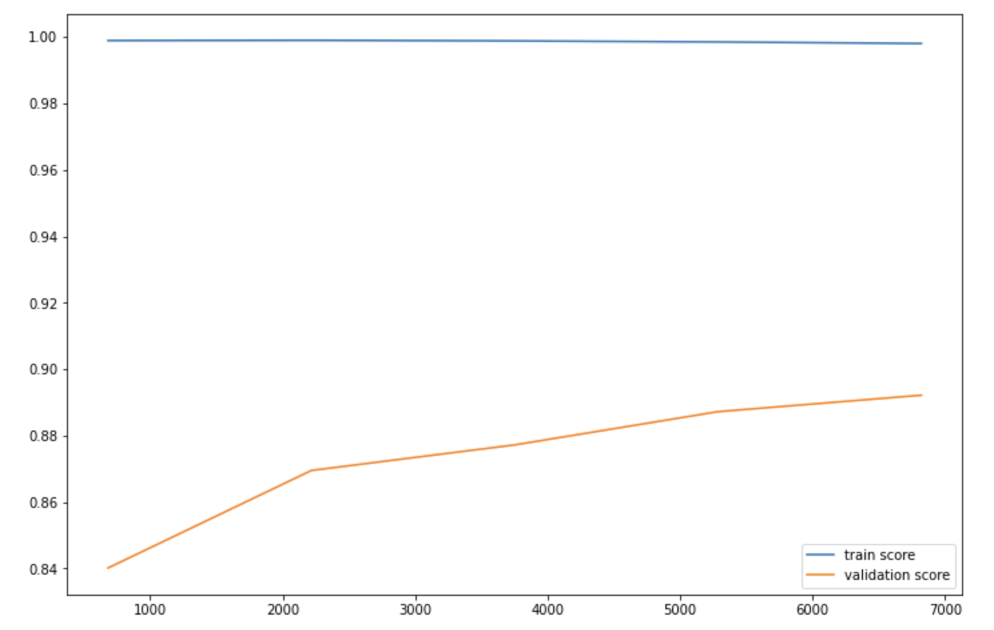
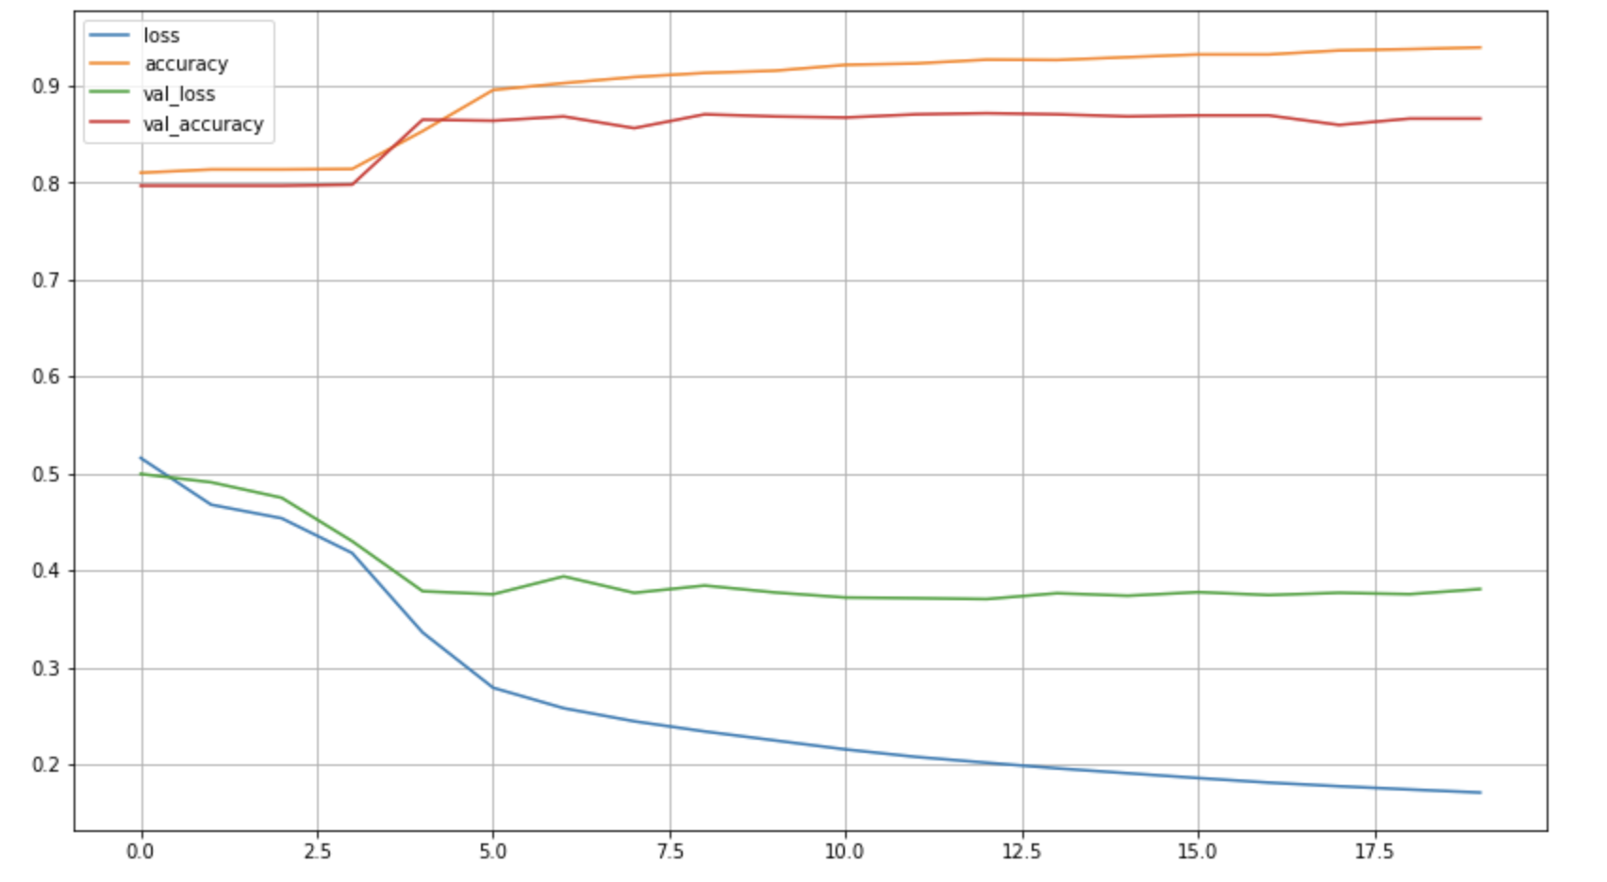
Results
SVM
Neural Network for Text Classification

Slide 4
Next Steps
Optimizer
Learning rate
Hidden layers
Location Keyword

